Slide 1
McCulloch-Pitts Neuron

Slide 2
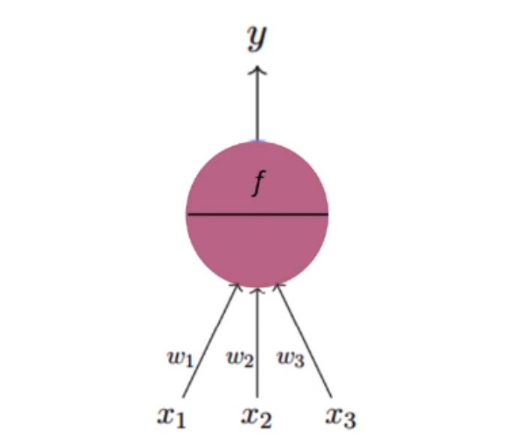
The Fundamental Architecture of Neuron
x1,x2,x3 are different factors(variables) on which your dependent variable depends. Each factor(variable) is assigned with some initial random weights. Neuron takes input as the linear aggregate of weighted factors. Then on top of the aggregate, apply some activation in order to predict y.

Slide 3
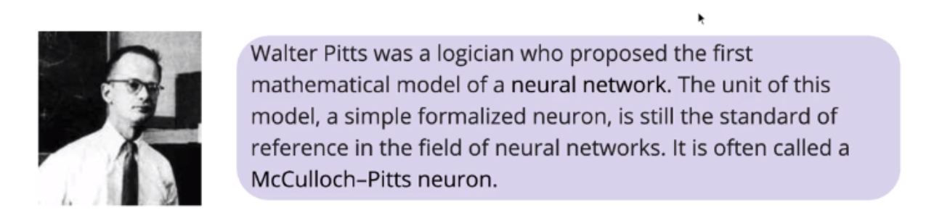
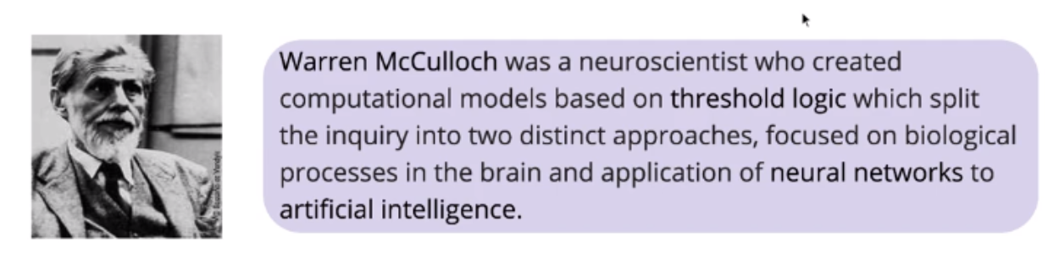
Who Proposed This Model

Slide 4
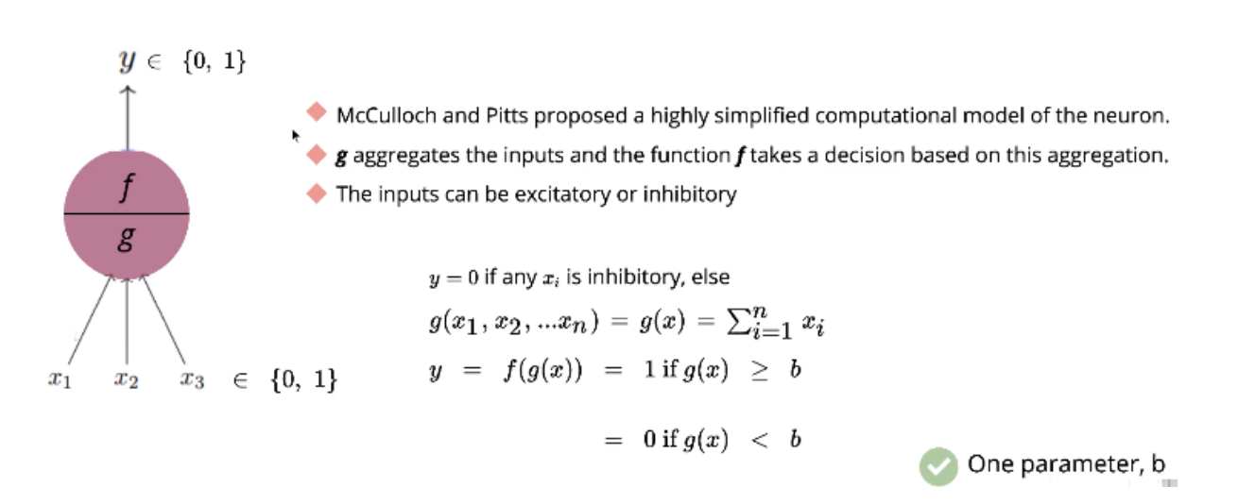
Mathematical model of MP Neuron

Slide 5
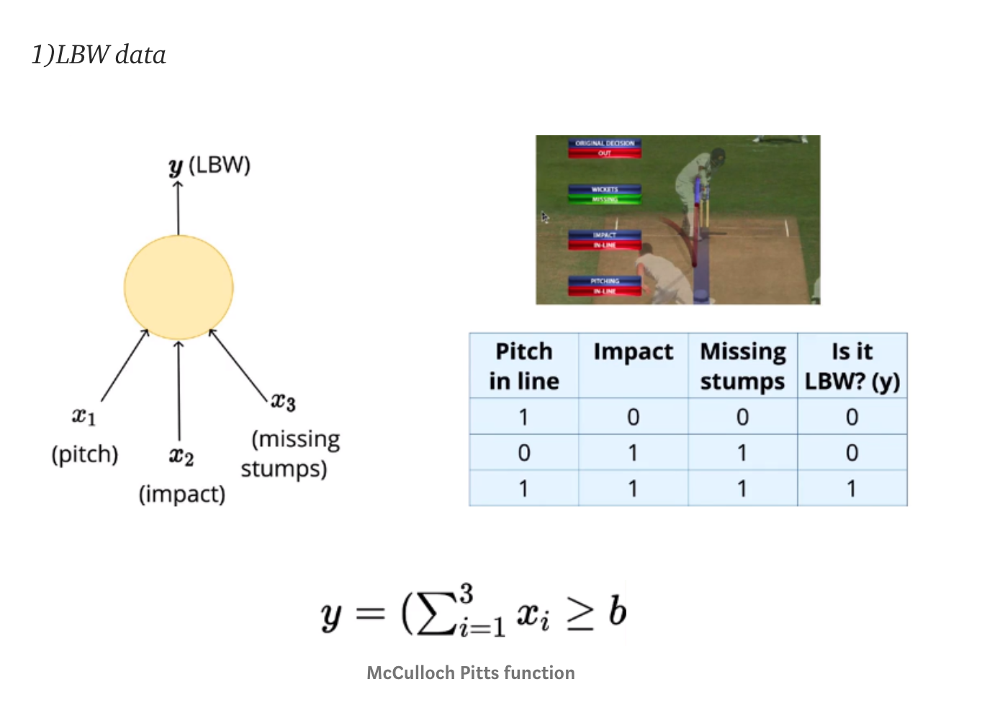
Data
Each variable takes binary input where the prediction was done using McCulloch Pitts function. Here adjust the threshold(b) in such a way that it works for all given data. Example — for the first row, (1+0+0)=1 so threshold “b” should be less than 1 in order to get y=0

Slide 6
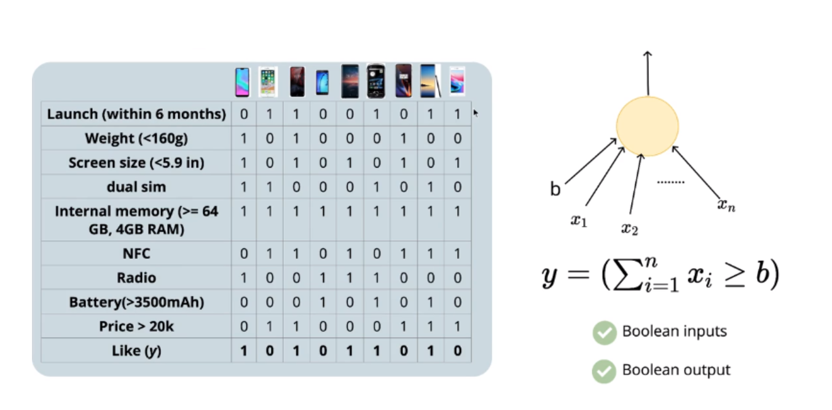
Model

Slide 7
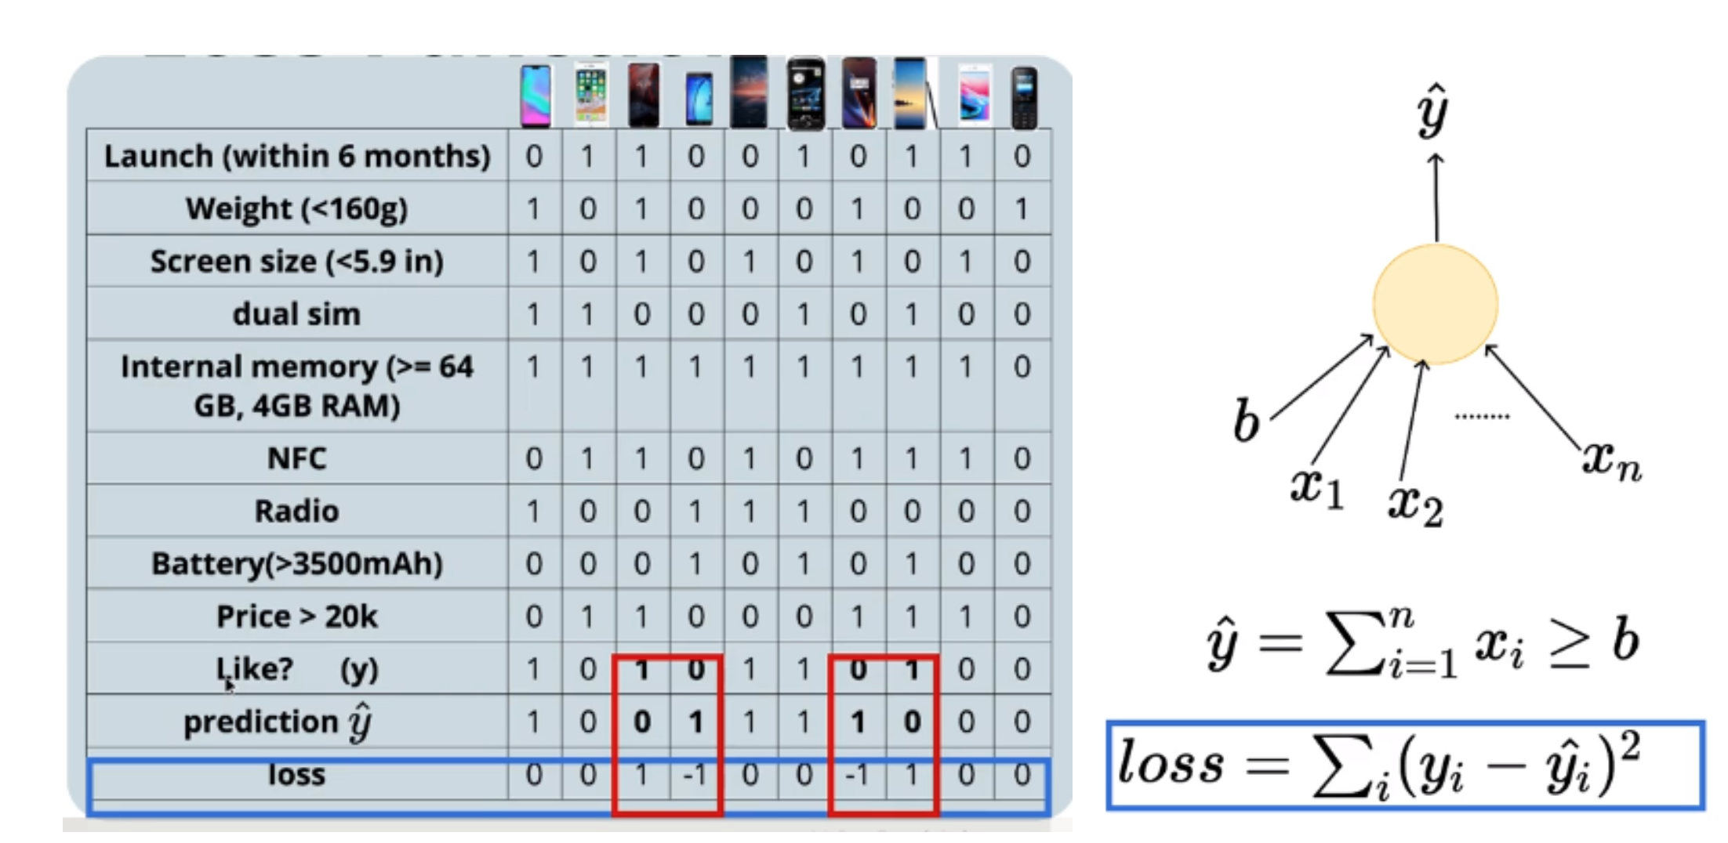
Loss
Here we take square of loss because the sum of simple difference (y-y^)may cancel out the positive and negative error. We also did not choose |y-y^| because it is not differentiable so gradient cannot be calculated to update loss.

Slide 8
Learning
Brute force search can afford one parameter.
For 10 observations, take “b” as (0,1,2,…10) and calculate the total loss for each b value. Plot loss vs “b”, the minimum value of loss will give optimal threshold(b).

Slide 9
Accuracy
Accuracy is given by the standard matrix of the division of the number of right predictions by the total number of predictions.

Slide 10
Limitation
Boolean input and output.
Fixed slope
Few intercepts possible
Fixed parameters

